Slide 1
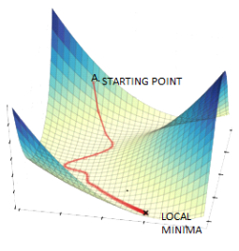
Gradient Descent
Image source: https://www.datasciencecentral.com/alternatives-to-the-gradient-descent-algorithm/, Accessed on 20/8/2022

Slide 2
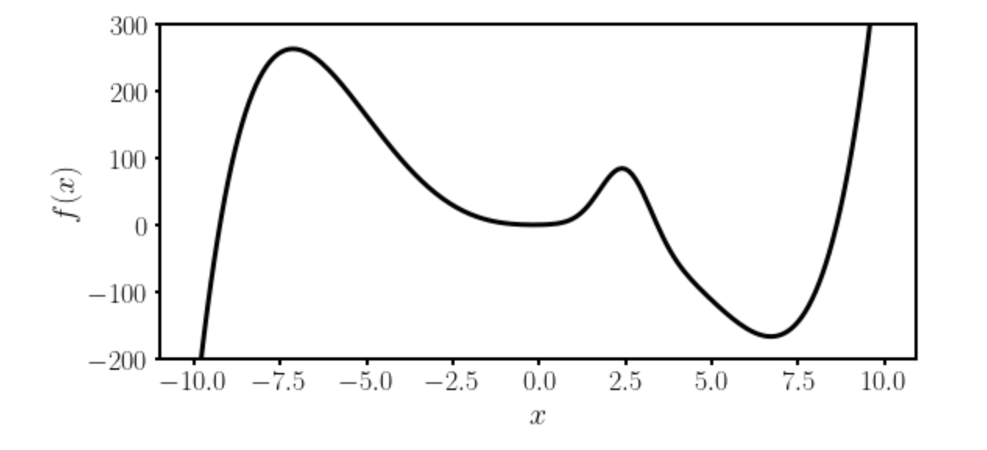
Gradient Descent I
Local minimum
Absolute minimum
Let’s suppose we want to find the absolute minimum of a given function $f(x)$.

Slide 3
Gradient Descent II
There is no analytical solution to the position of the absolute minimum for a generical algorithm (at least not as in easy cases as linear regression).
Thus numerical methods are required.

Slide 4


Gradient Descent III
The most used method is called Gradient Descent and uses the following formula (in 1-Dimension)
$$x_{n+1}→x_{n}−γ \frac{df}{dx}(x_{n})$$
Slope of the
function to be
minimized
New minimum location
approximation
Previous minimum location
approximation
Learning rate
The starting point $x_{0}$ is crucial.
Which one should we choose? Does it make a difference?

Slide 5

Gradient Descent IV
Update slow (slope is near zero)
Very fast update
Slope of the
function to be
minimized
$$x_{n+1}→x_{n}−γ \frac{df}{dx}(x_{n})$$

Slide 6
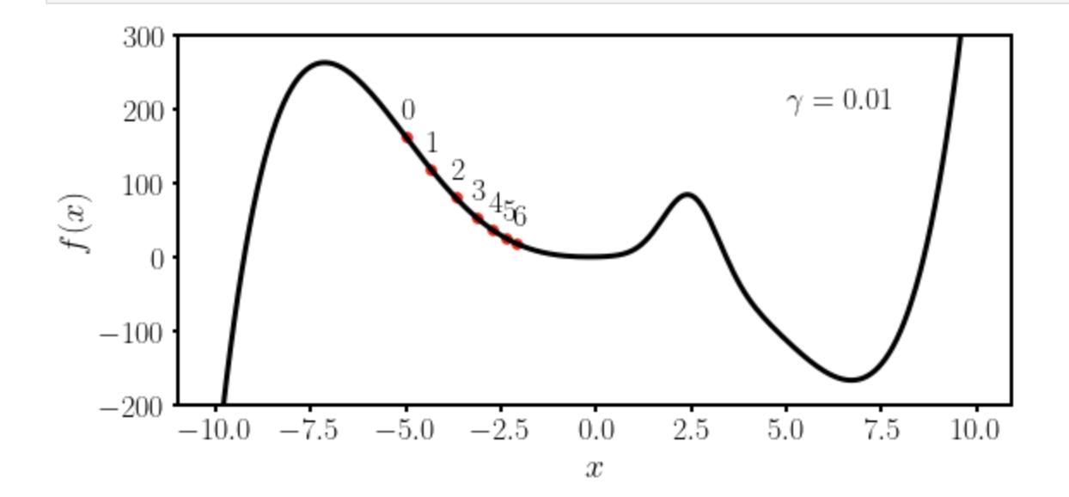
Gradient Descent V
Let’s suppose we want to find the absolute minimum of a given function $f(x)$.
We choose $x_{0}=−5$ and $γ=0.01$

Slide 7
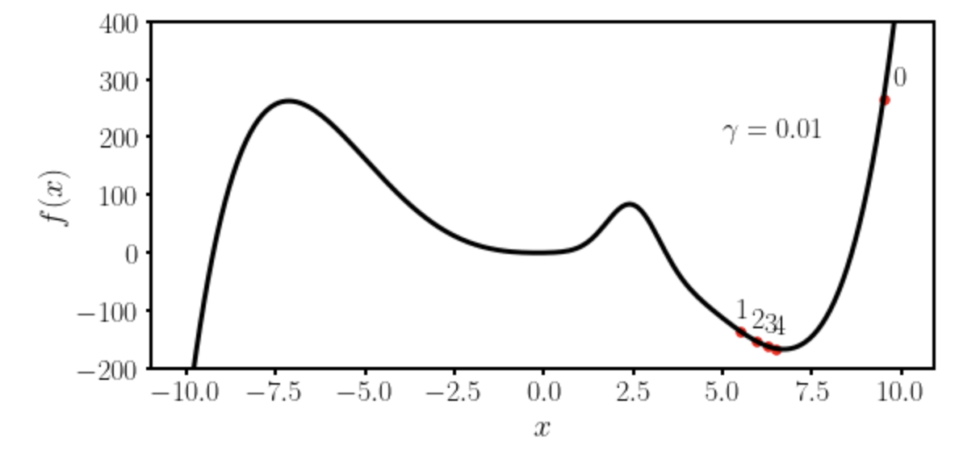
Gradient Descent VI
Let’s suppose we want to find the absolute minimum of a given function $f(x)$.
We choose $x_{0}=−9.5$ and $γ=0.01$

Slide 8
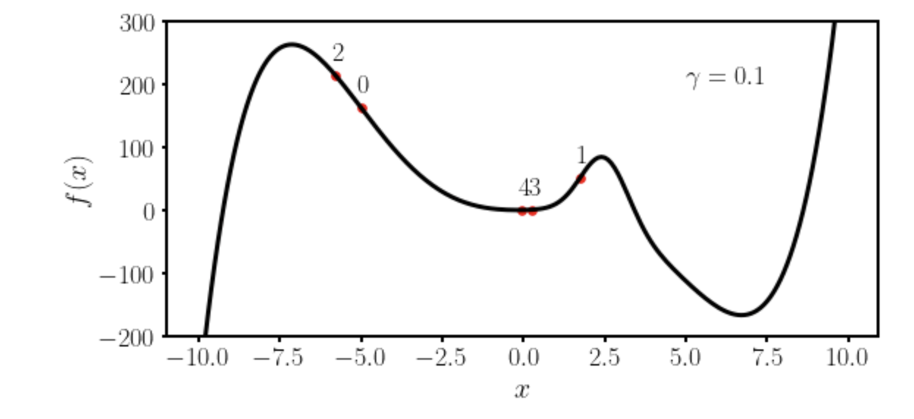
Gradient Descent VII
Let’s suppose we want to find the absolute minimum of a given function $f(x)$.
We choose $x_{0}=−5$ and $γ=0.1$

Slide 9
Some remarks about gradient descent
To use gradient descent you will need the derivative (or gradient in multiple dimensions) of the function you want to minimize.
→ Gradient descent is not the most efficient way of finding minima. It gets easily stuck in local minima. More advanced optimisers have been developed and are typically used (see Adam).

Slide 10



Gradient Descent - Example
We want to minimize the function
Gradient Descent Formula

Slide 11
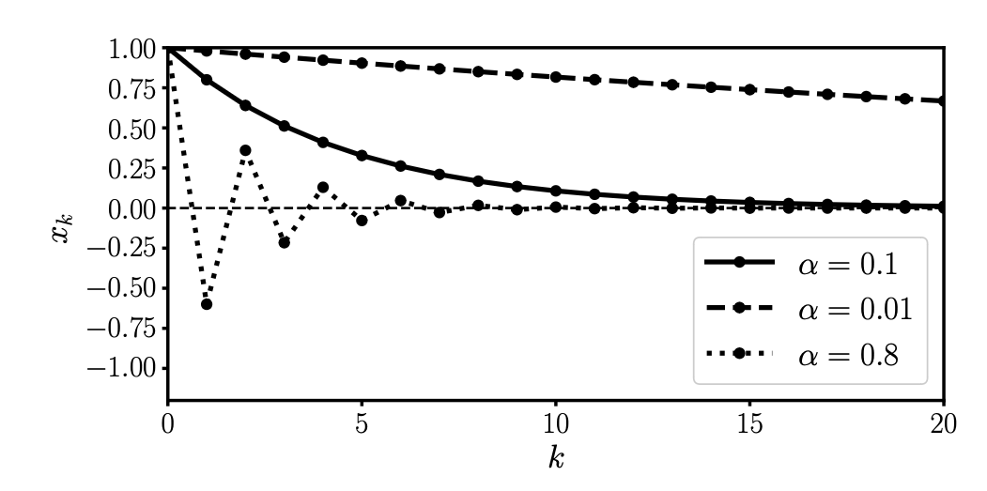
Gradient Descent - Example

Slide 12
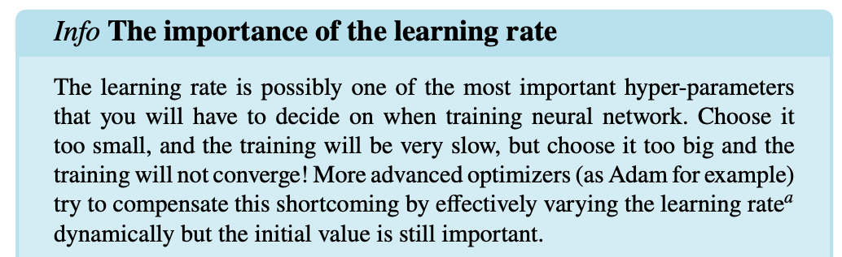
Gradient Descent - Example

Slide 13
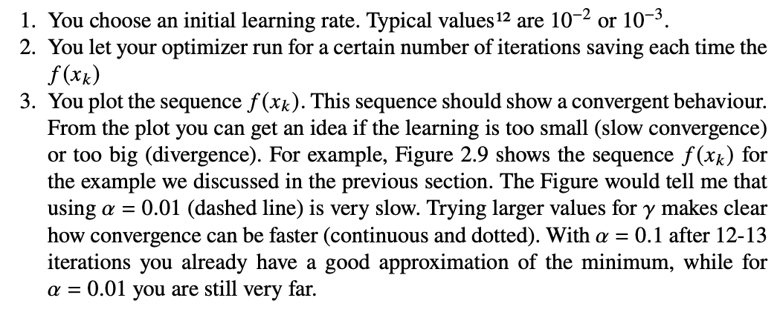
Choosing the right learning rate

Slide 14
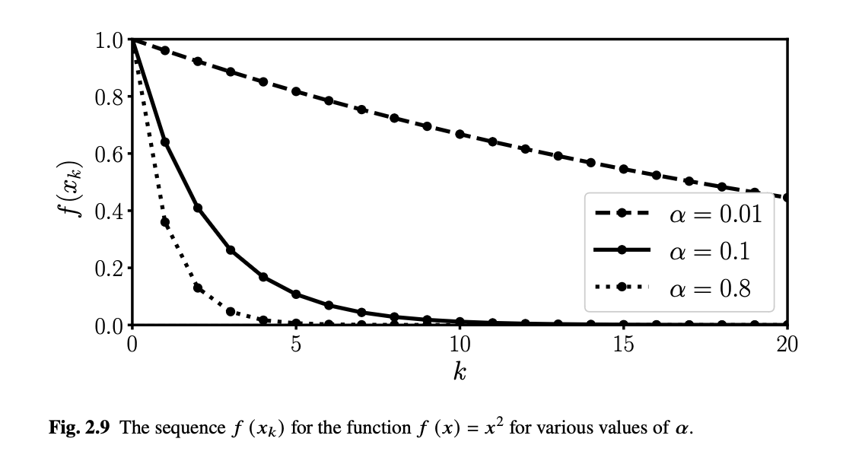
Choosing the right learning rate

Slide 15
Variations of Gradient Descent

Slide 16
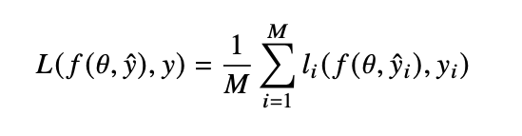
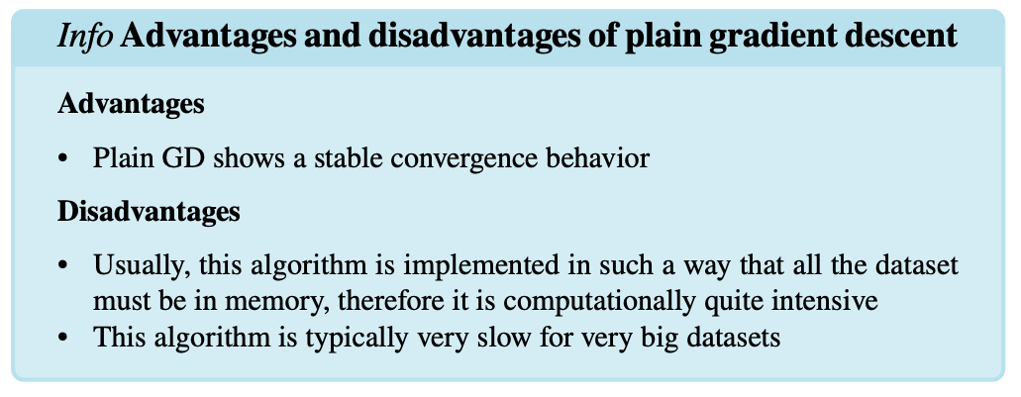
Plain GD
Number of sampes
Loss function
Label
Model Parameters
Model output

Slide 17
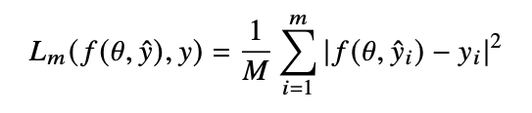
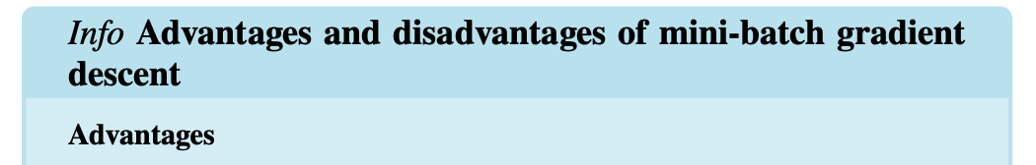
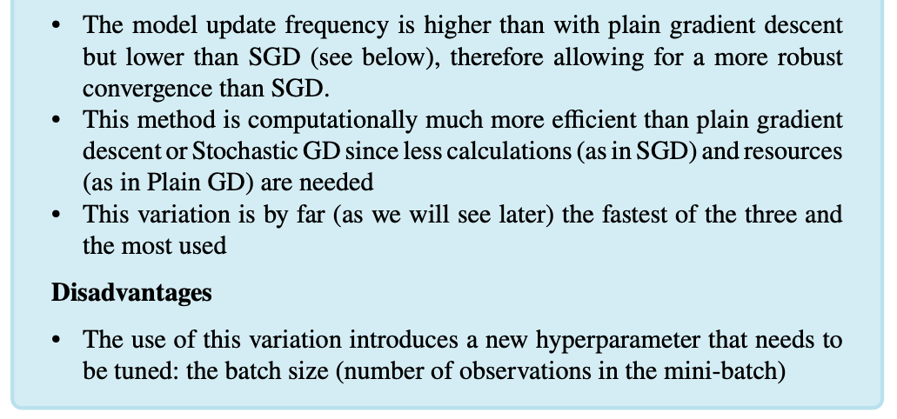

Mini-Batch GD
$$m<M$$

Slide 18
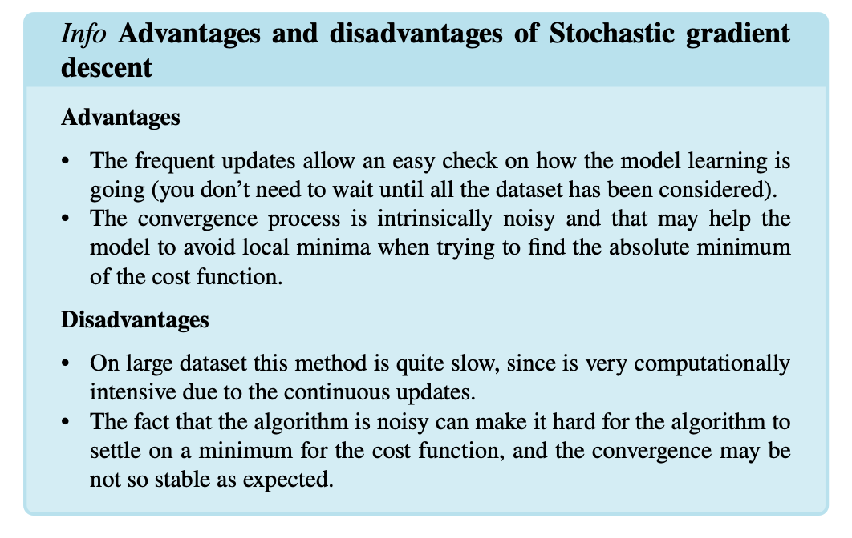

Stochastic GD
$$m=1$$

Slide 19
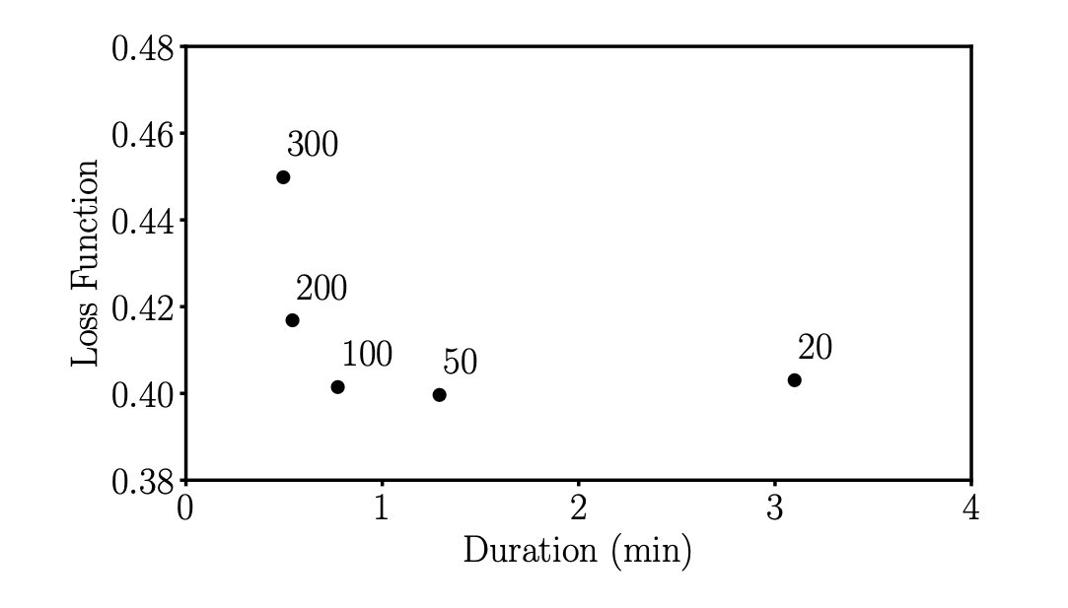
The right mini-batch size

